Slide 1






Blended Learning Methodologies for
Capacity Development
Digital identity for
Trade and Development
Your title here
Submodule here
Dominique Chantrel / UNCTAD
Mark Assaf / UNCTAD

Slide 2
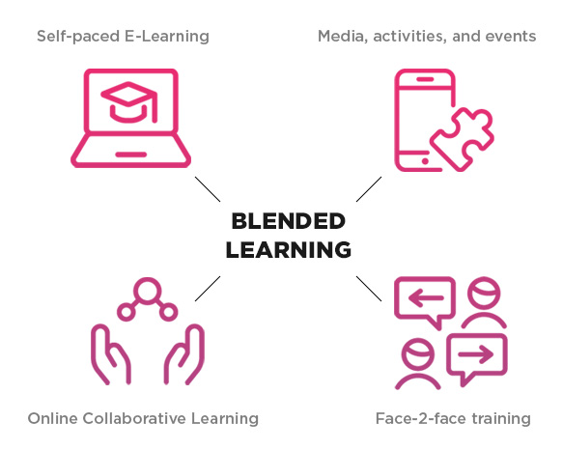
TRAINFORTRADE BLENDED LEARNING APPROACH
Blended learning gives trainees as well as trainers more flexibility in the training process. Access to knowledge and information can take place across time and distance using technologies.
Methodology:
The TrainForTrade courses are developed following a rigorous methodology, in close collaboration with the government and other stakeholders in order to address the country’s training needs.
Train the trainers
Networking amongst beneficiary countries
The courses are multilingual
Open sources LMS

Slide 3
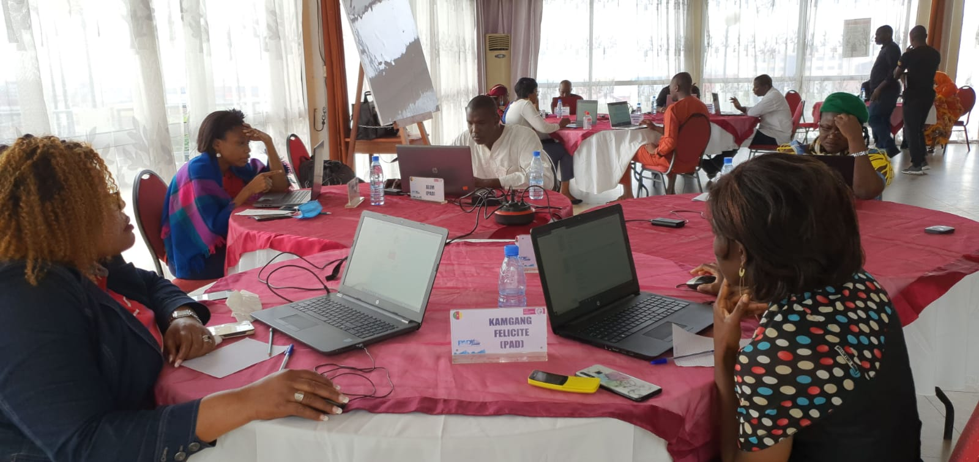
STAGES OF PROGRAMME
Course development process example
2020 1s
2019 2s
2019 2s
6 months
Policy advice
Sharing & publication
Webinar
&
F2f Follow-up
On-line Delivery
Course Development

Slide 4

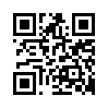
LEAVING NO ONE BEHIND
Mark Assaf
Chief
HRD Section/TrainForTrade
UNCTAD
Tel: + 41 22 917 5481
E-mail: mark.assaf@un.org
Dominique Chantrel
Programme Manager
HRD Section/TrainForTrade
UNCTAD
Tel: + 41 22 917 2187
E-mail: dominique.chantrel@un.org
http://tft.unctad.org

